Slide 1

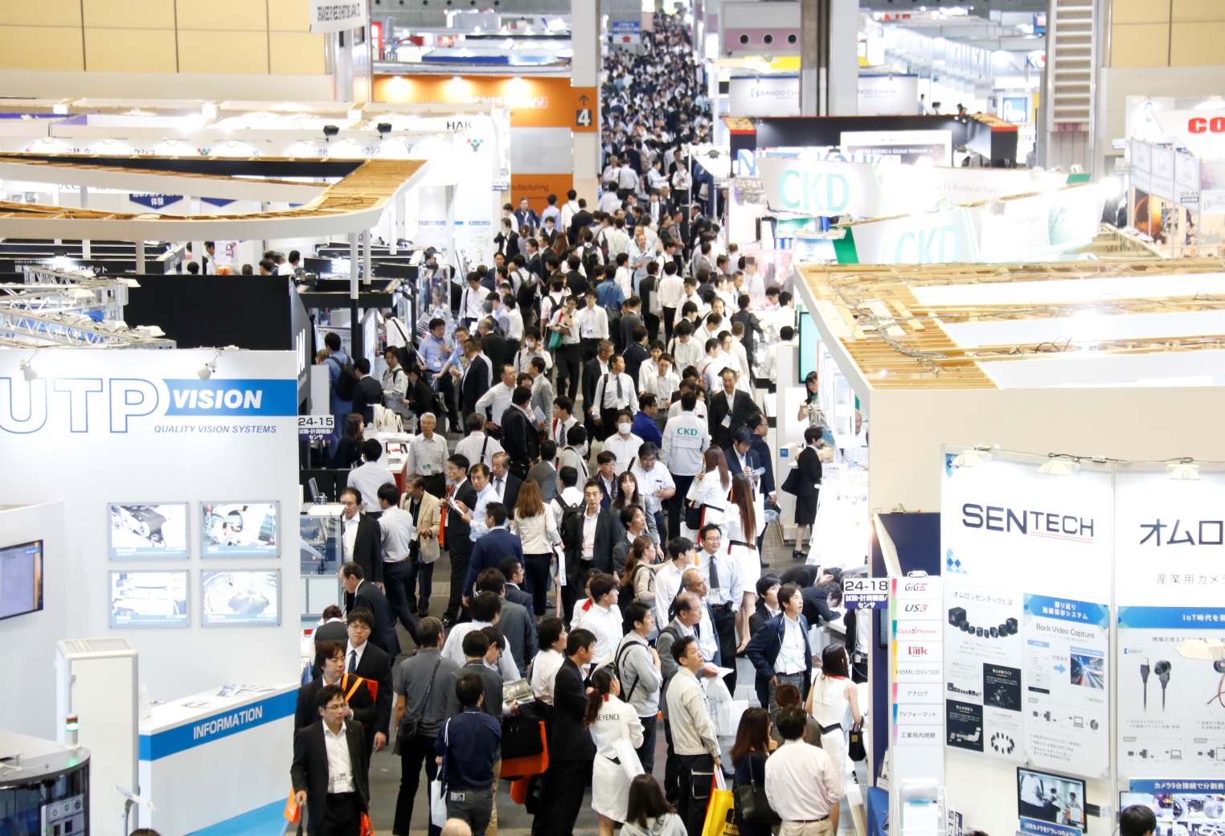
Dates: October 3 [Wed] – 5 [Fri], 2018
Venue: INTEX Osaka , Japan
Organiser: Reed Exhibitions Japan Ltd.
Breaking its records!
- 1,233 Exhibitors & 38,673 Visitors -
■ Asia’s Leading Manufacturing Industry Show!
“21st Manufacturing World Osaka" is Asia’s leading trade show for manufacturing industry held at INTEX Osaka, Japan from October 3 - 5, 2018. The number of exhibitors and visitors recorded the largest number in its history. The show ground was completely full occupied by exhibit booths (sold out all exhibit spaces) and the show was completely packed by exciting atmosphere.

Slide 2
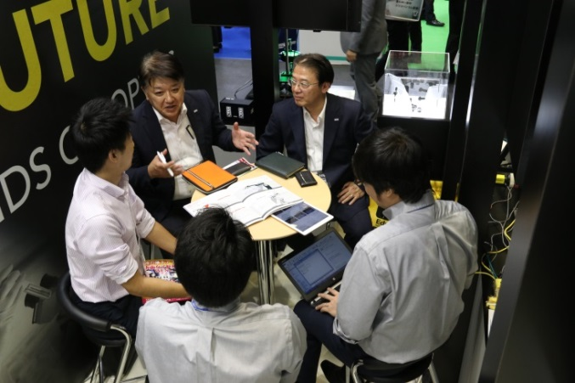
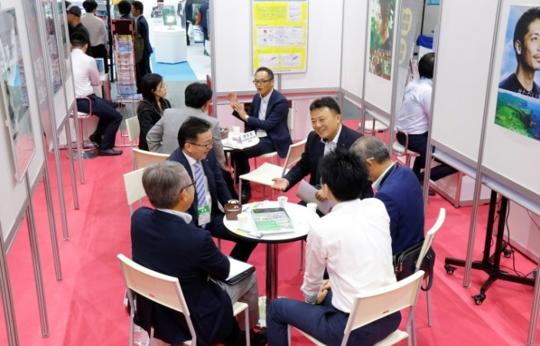
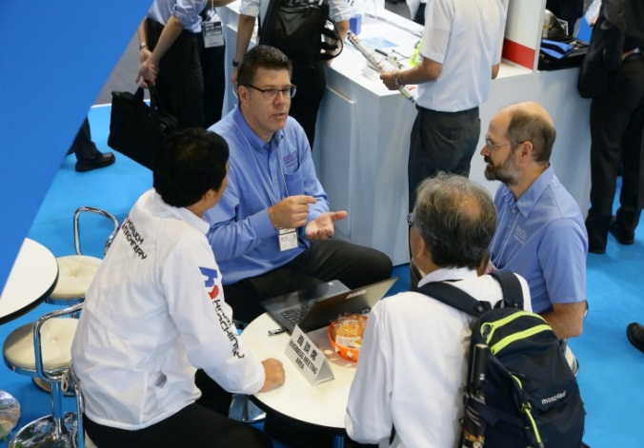
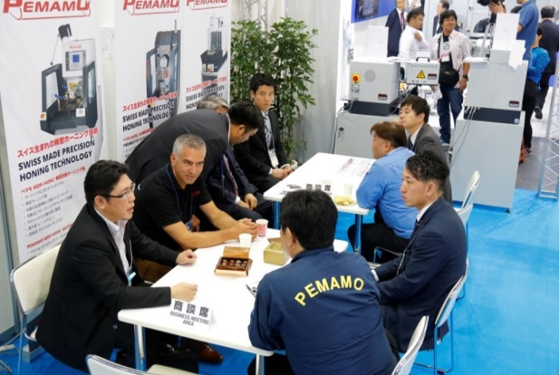
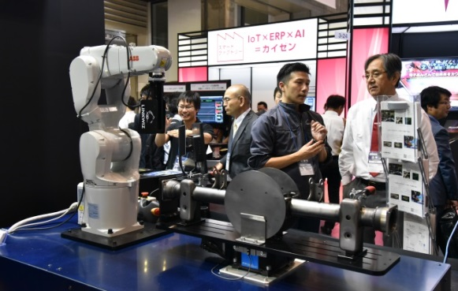
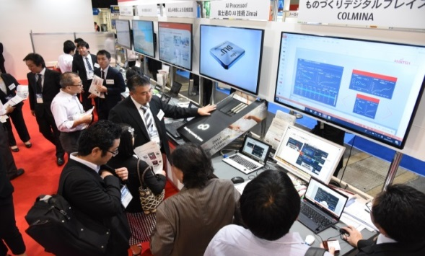
Dates: October 3 [Wed] – 5 [Fri], 2018
Venue: INTEX Osaka , Japan
Organiser: Reed Exhibitions Japan Ltd.
■ Business meetings were seen everywhere throughout the halls
Since this show is recognized as a must-attend show for manufacturing industry, most industry professionals not only from exhibitors, but also from visitors participated in 21st Manufacturing World Osaka. Therefore, business meetings were seen everywhere in the show venue.
■ World’s highest quality technologies, solutions and products were exhibited!
Japanese manufacturers known as the most strict standard for the quality, exhibited their latest technologies, solutions and products. 21st Manufacturing World Osaka was surely the place where visitors could meet the world’s highest quality technologies.

Slide 3
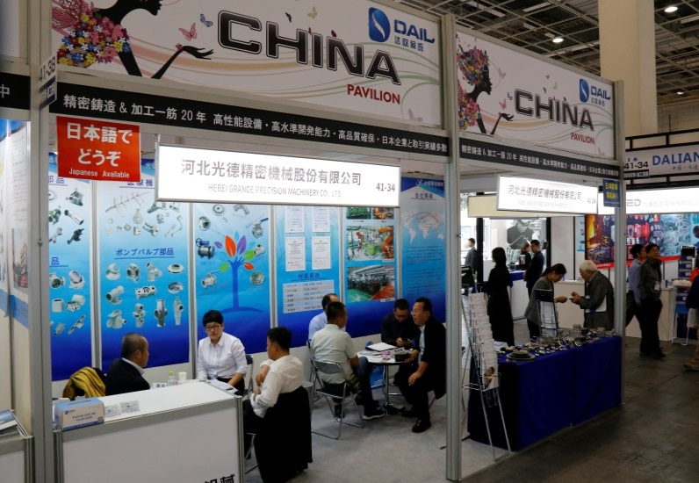
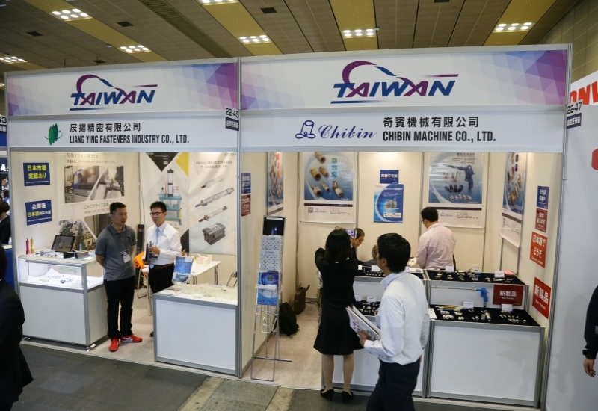
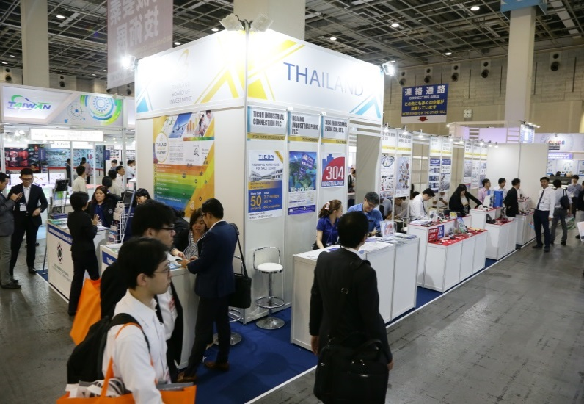
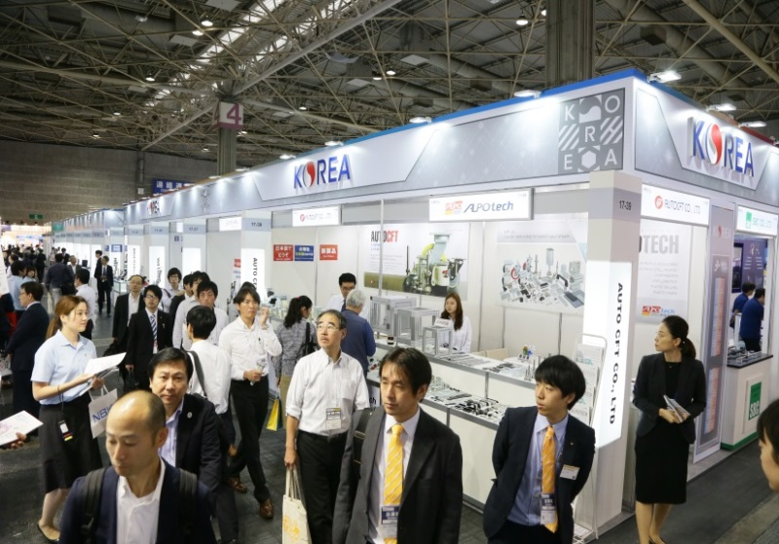
Dates: October 3 [Wed] – 5 [Fri], 2018
Venue: INTEX Osaka , Japan
Organiser: Reed Exhibitions Japan Ltd.
■ International business expands
Various foreign associations, governmental bodies participated at the show in order to invest deeper into the Japanese/Asian market and also held various official meetings.
A number of countries held national pavilions to illustrate their devotion towards the Japanese market and gathered exhibitors representing their country. This year CHINA, TAIWAN, KOREA, THAILAND, and VIETNAM had national pavilions.
■ The number of international exhibitors are 230 this year!
Reaching the growing need for overseas transactions which will become increasingly important, overall the international participation of both exhibitors and visitors for instance have been continually expanding. This trend is expected to become even larger in the future.
< Pictures of national pavilions from previous show (excerpt) >
CHINA PAVILION
TAIWAN PAVILION
THAILAND PAVILION
KOREA PAVILION

Slide 4
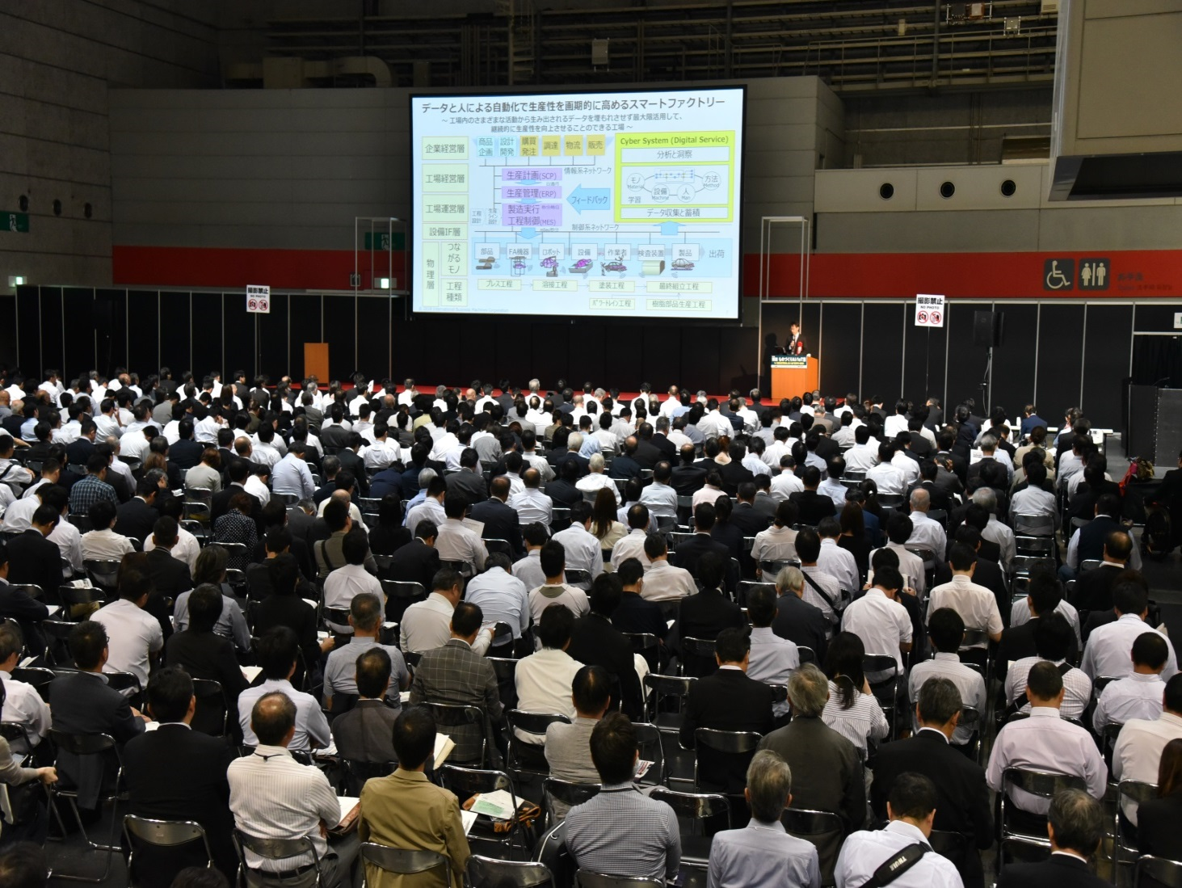
Dates: October 3 [Wed] – 5 [Fri], 2018
Venue: INTEX Osaka , Japan
Organiser: Reed Exhibitions Japan Ltd.
■ Technical conference attracted huge number of attendees
23 conferences/seminars were held together with the trade show. Top industry leaders from global leading manufacturers such as HONDA MOTOR, KUBOTA, OLYMPUS, RICOH, NISSAN MOTOR, MAZDA MOTOR, etc. revealed their latest topics for manufacturing innovation, IoT technology, smart factory, IT strategy for manufacturing industry etc.
8,644 attendees joined the seminar. (This figure is not double counted with trade show visitors.)
Scenes from 2018 keynote session

Slide 5
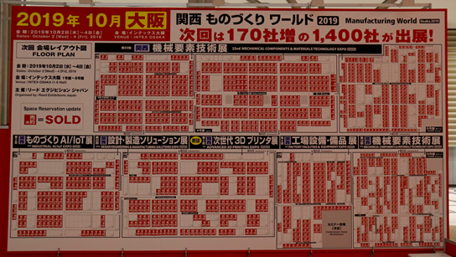
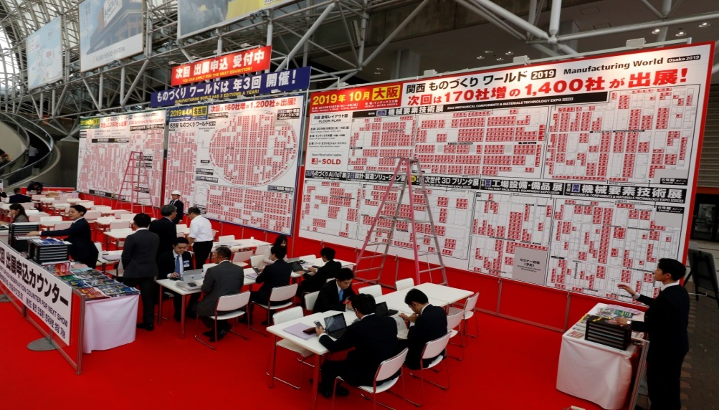
Dates: October 3 [Wed] – 5 [Fri], 2018
Venue: INTEX Osaka , Japan
Organiser: Reed Exhibitions Japan Ltd.
■ Exhibit booths are selling out fast!
According to the huge success of the show such as a growing profile of exhibits, world class conference and expanding international mix of both exhibitors and visitors, the show concluded with a positive note with majority of the booth space sold-out already for coming editions. Exhibitors are urged to contact Show Management mfg-osaka@reedexpo.co.jp to discuss available booth space. Below is a photograph of the floor plan shot at the exhibit space reservation counter on the final day of the show. The red squares represent the booth space that has been already reserved.
<Condition of exhibit space reservation from 5pm of the final day at the show>
<A scene of exhibit space reservation counter at the show>

Slide 6
Dates: October 3 [Wed] – 5 [Fri], 2018
Venue: INTEX Osaka , Japan
Organiser: Reed Exhibitions Japan Ltd.
“Manufacturing World” is world’s leading manufacturing industry show held 3 times a year in Tokyo, Osaka and Nagoya.
Official
Website
Dates: February 6 (Wed) – 8 (Fri), 2019
Venue: Tokyo Big Sight, Japan
Official
Website
Dates: April 17 (Wed) – 19 (Fri), 2019
Venue: Portmesse Nagoya, Japan
Official
Website
Dates: October 2 (Wed) – 4 (Fri), 2019
Venue: INTEX Osaka, Japan

Slide 7
Dates: October 3 [Wed] – 5 [Fri], 2018
Venue: INTEX Osaka , Japan
Organiser: Reed Exhibitions Japan Ltd.
Contact:
Organiser: Reed Exhibitions Japan Ltd. Manufacturing World Show Management
Erika Suzuki (Ms.)
TEL：+81-(0)3-3349-8506
FAX：+81-(0)3-3349-8500
Email：mfg-osaka@reedexpo.co.jp
18F Shinjuku-Nomura Bldg., 1-26-2 Nishishinjuku,
Shinjuku-ku, Tokyo 163-0570, Japan

